Slide 1
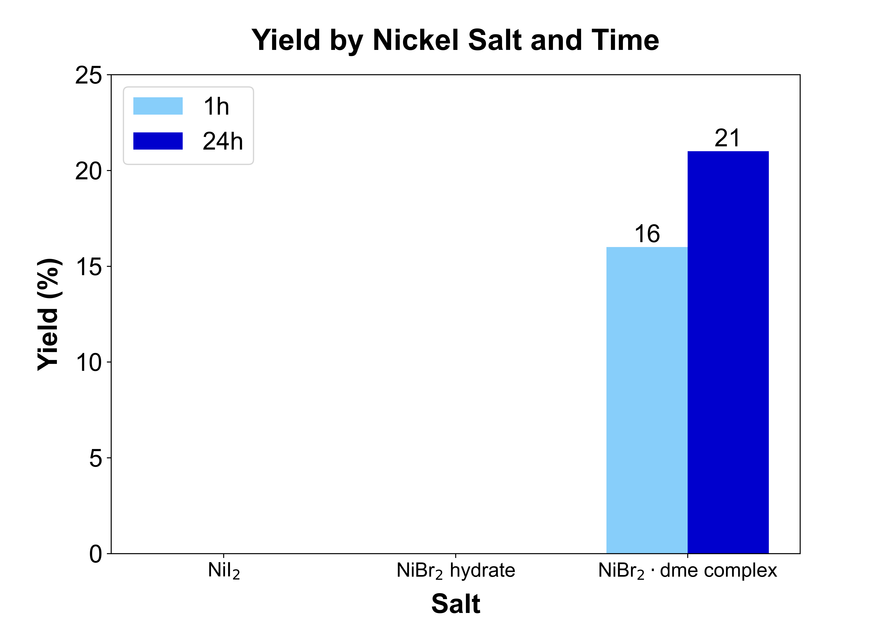
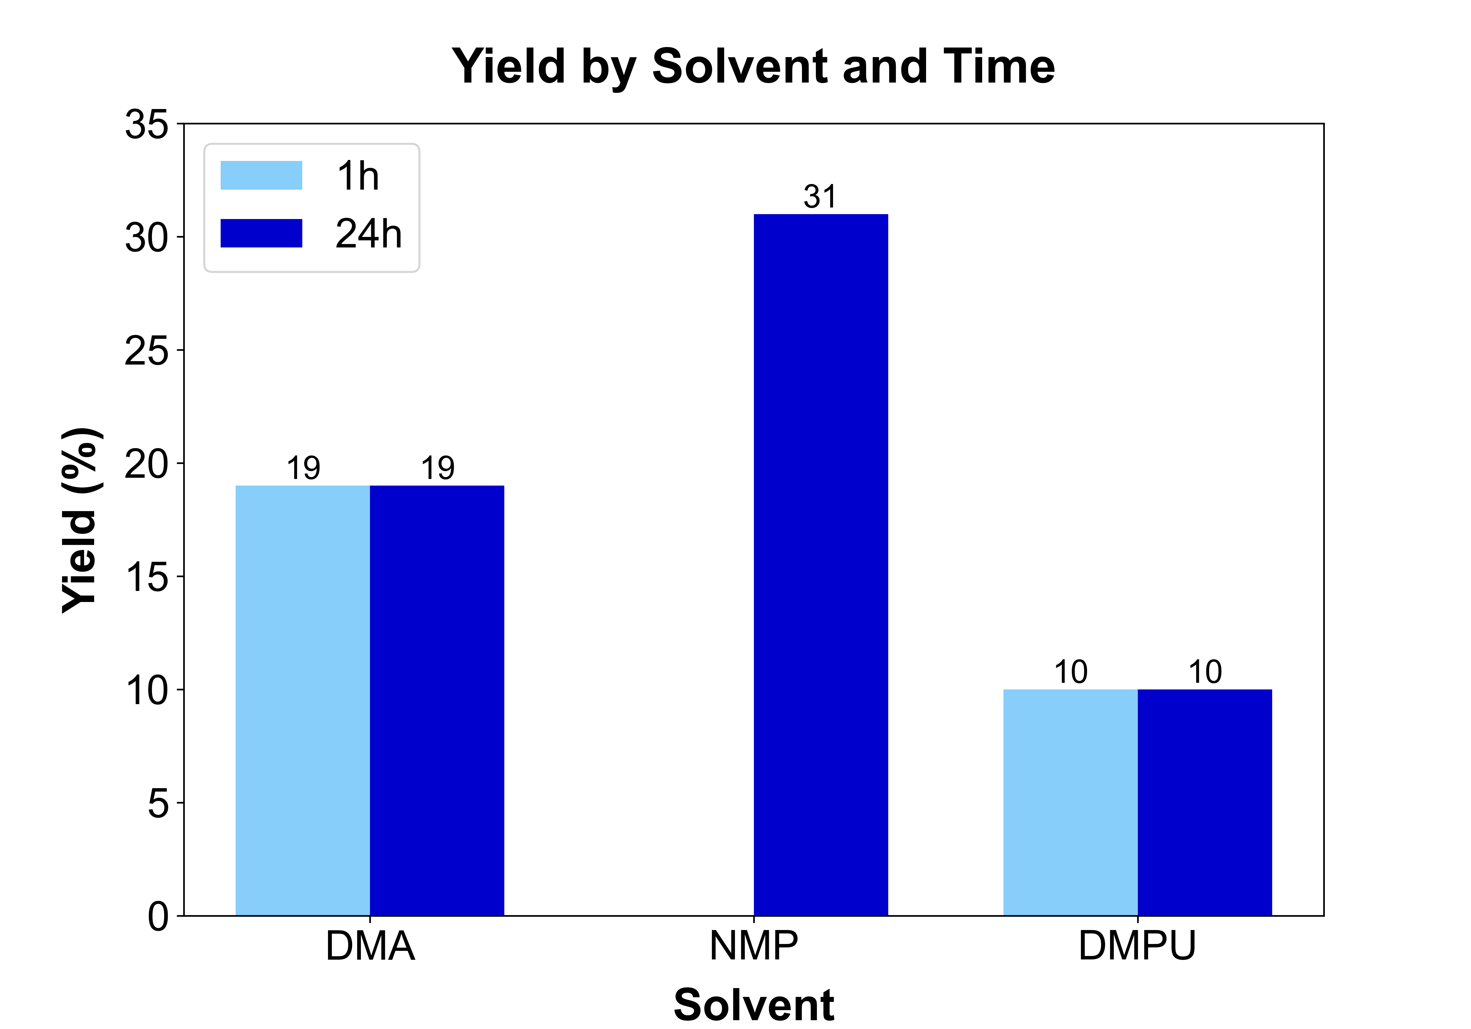
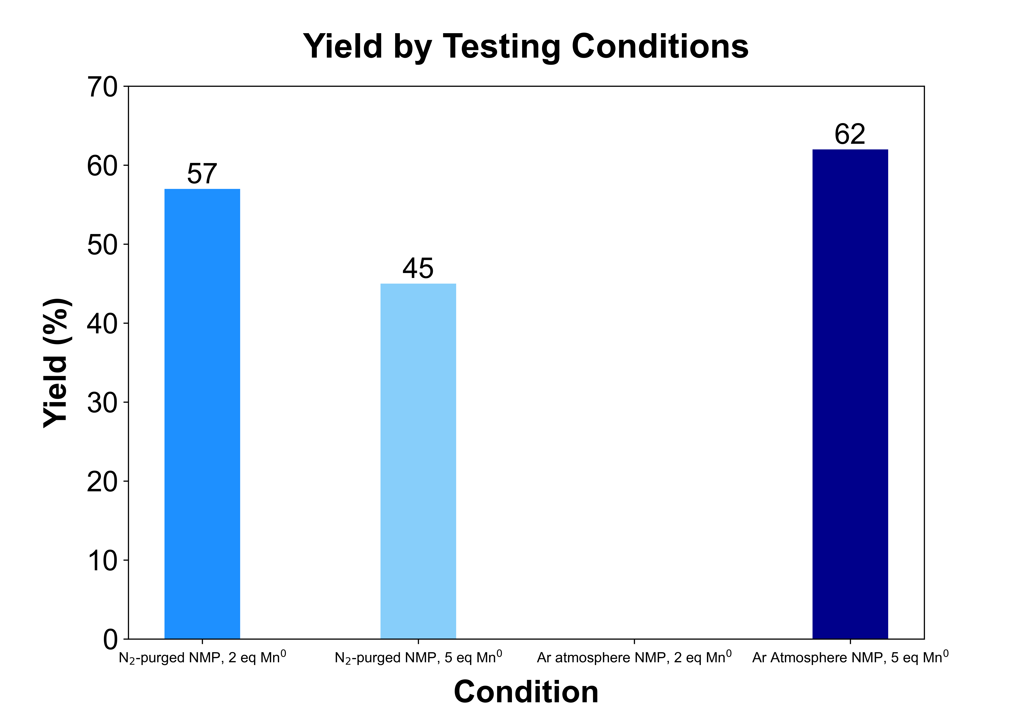
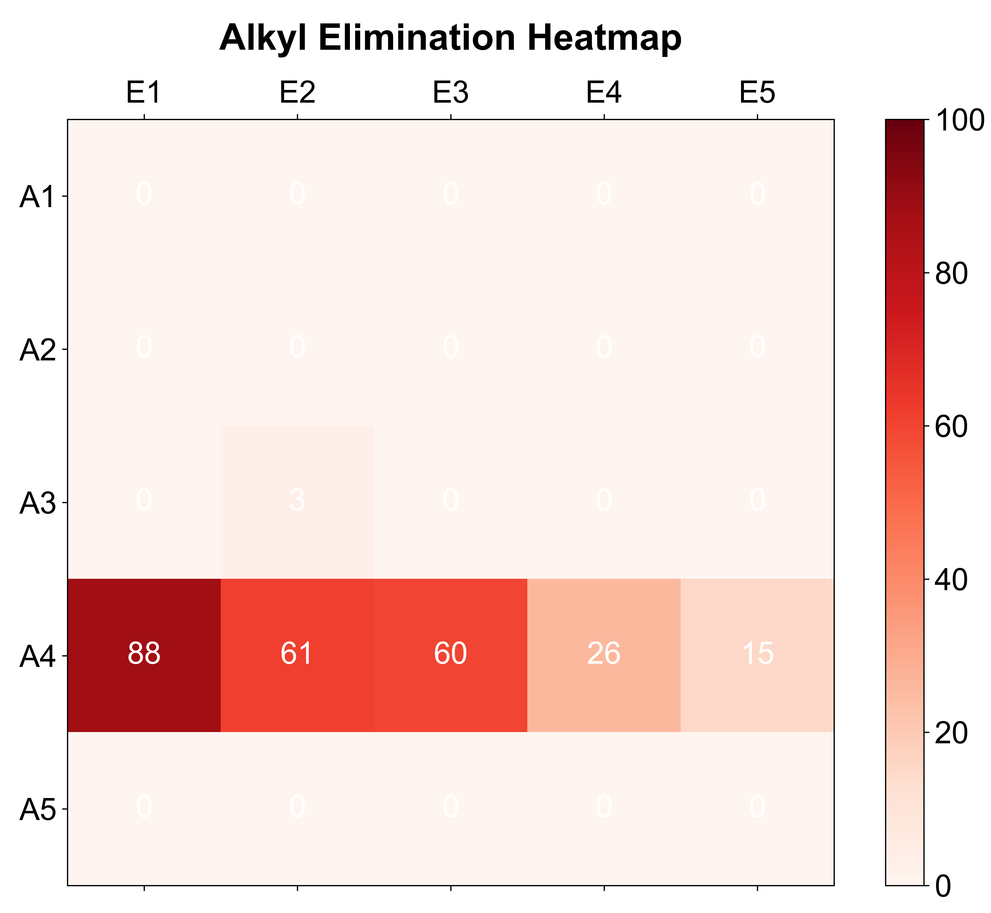
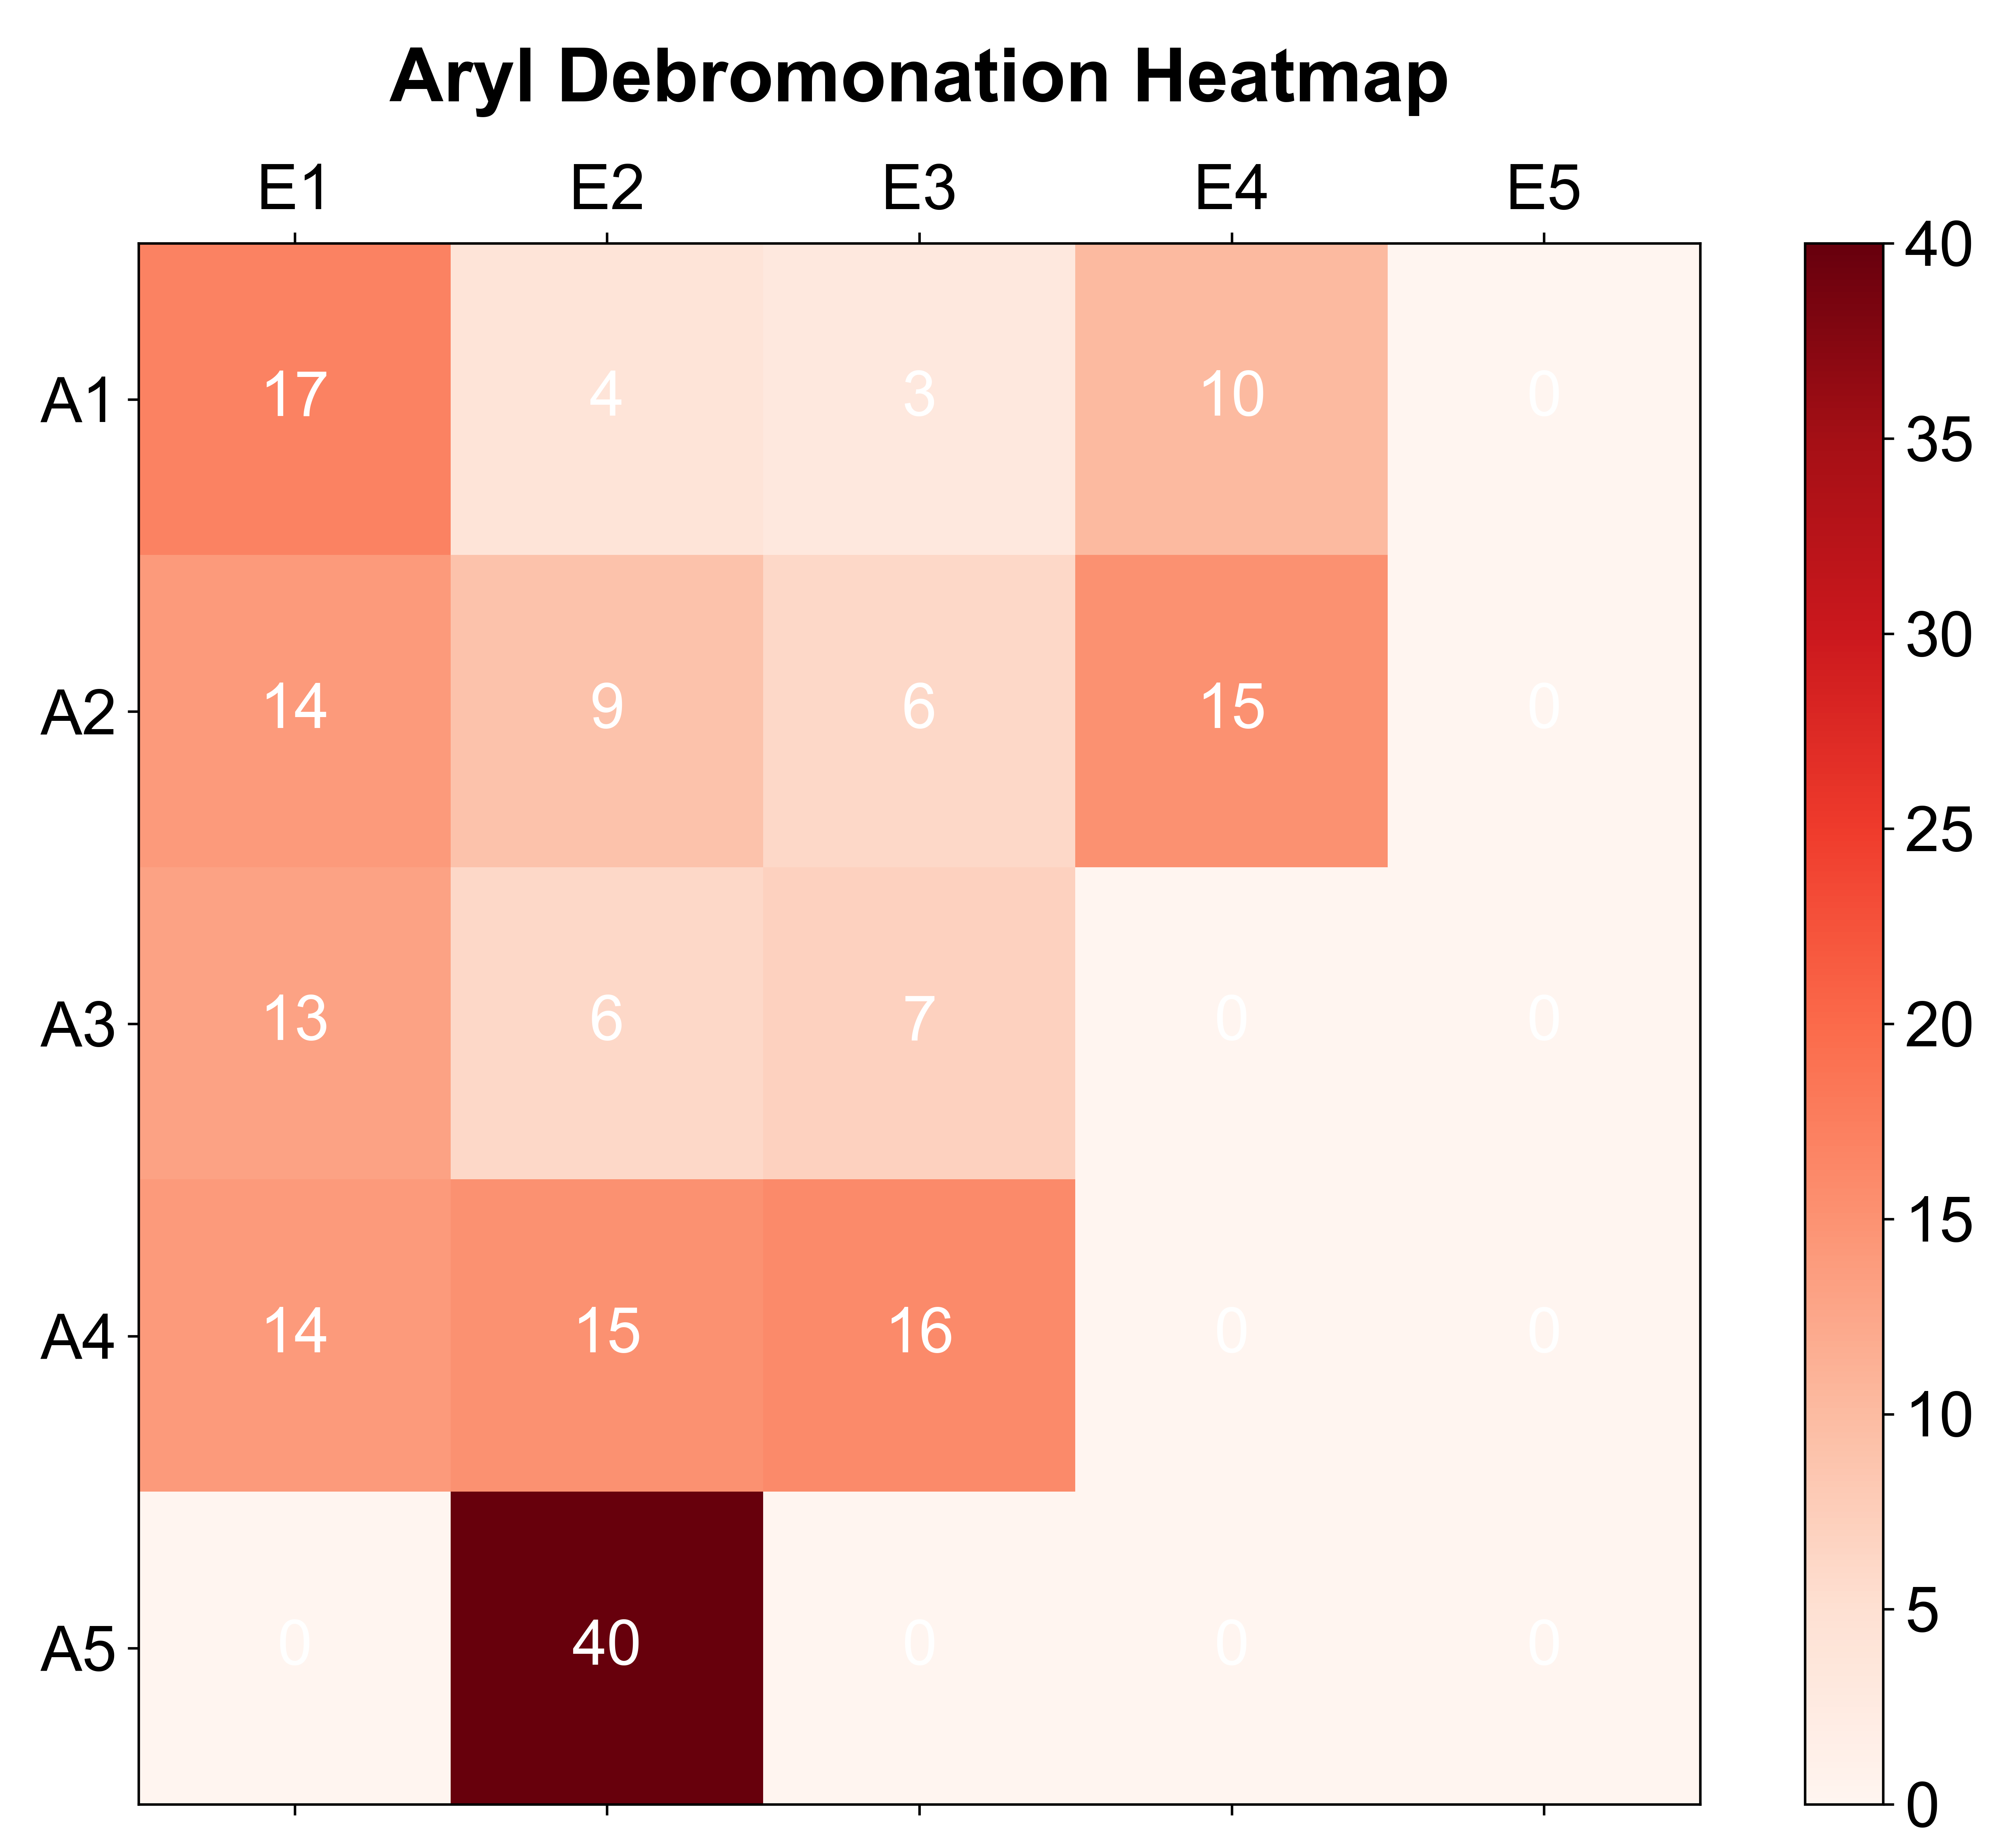
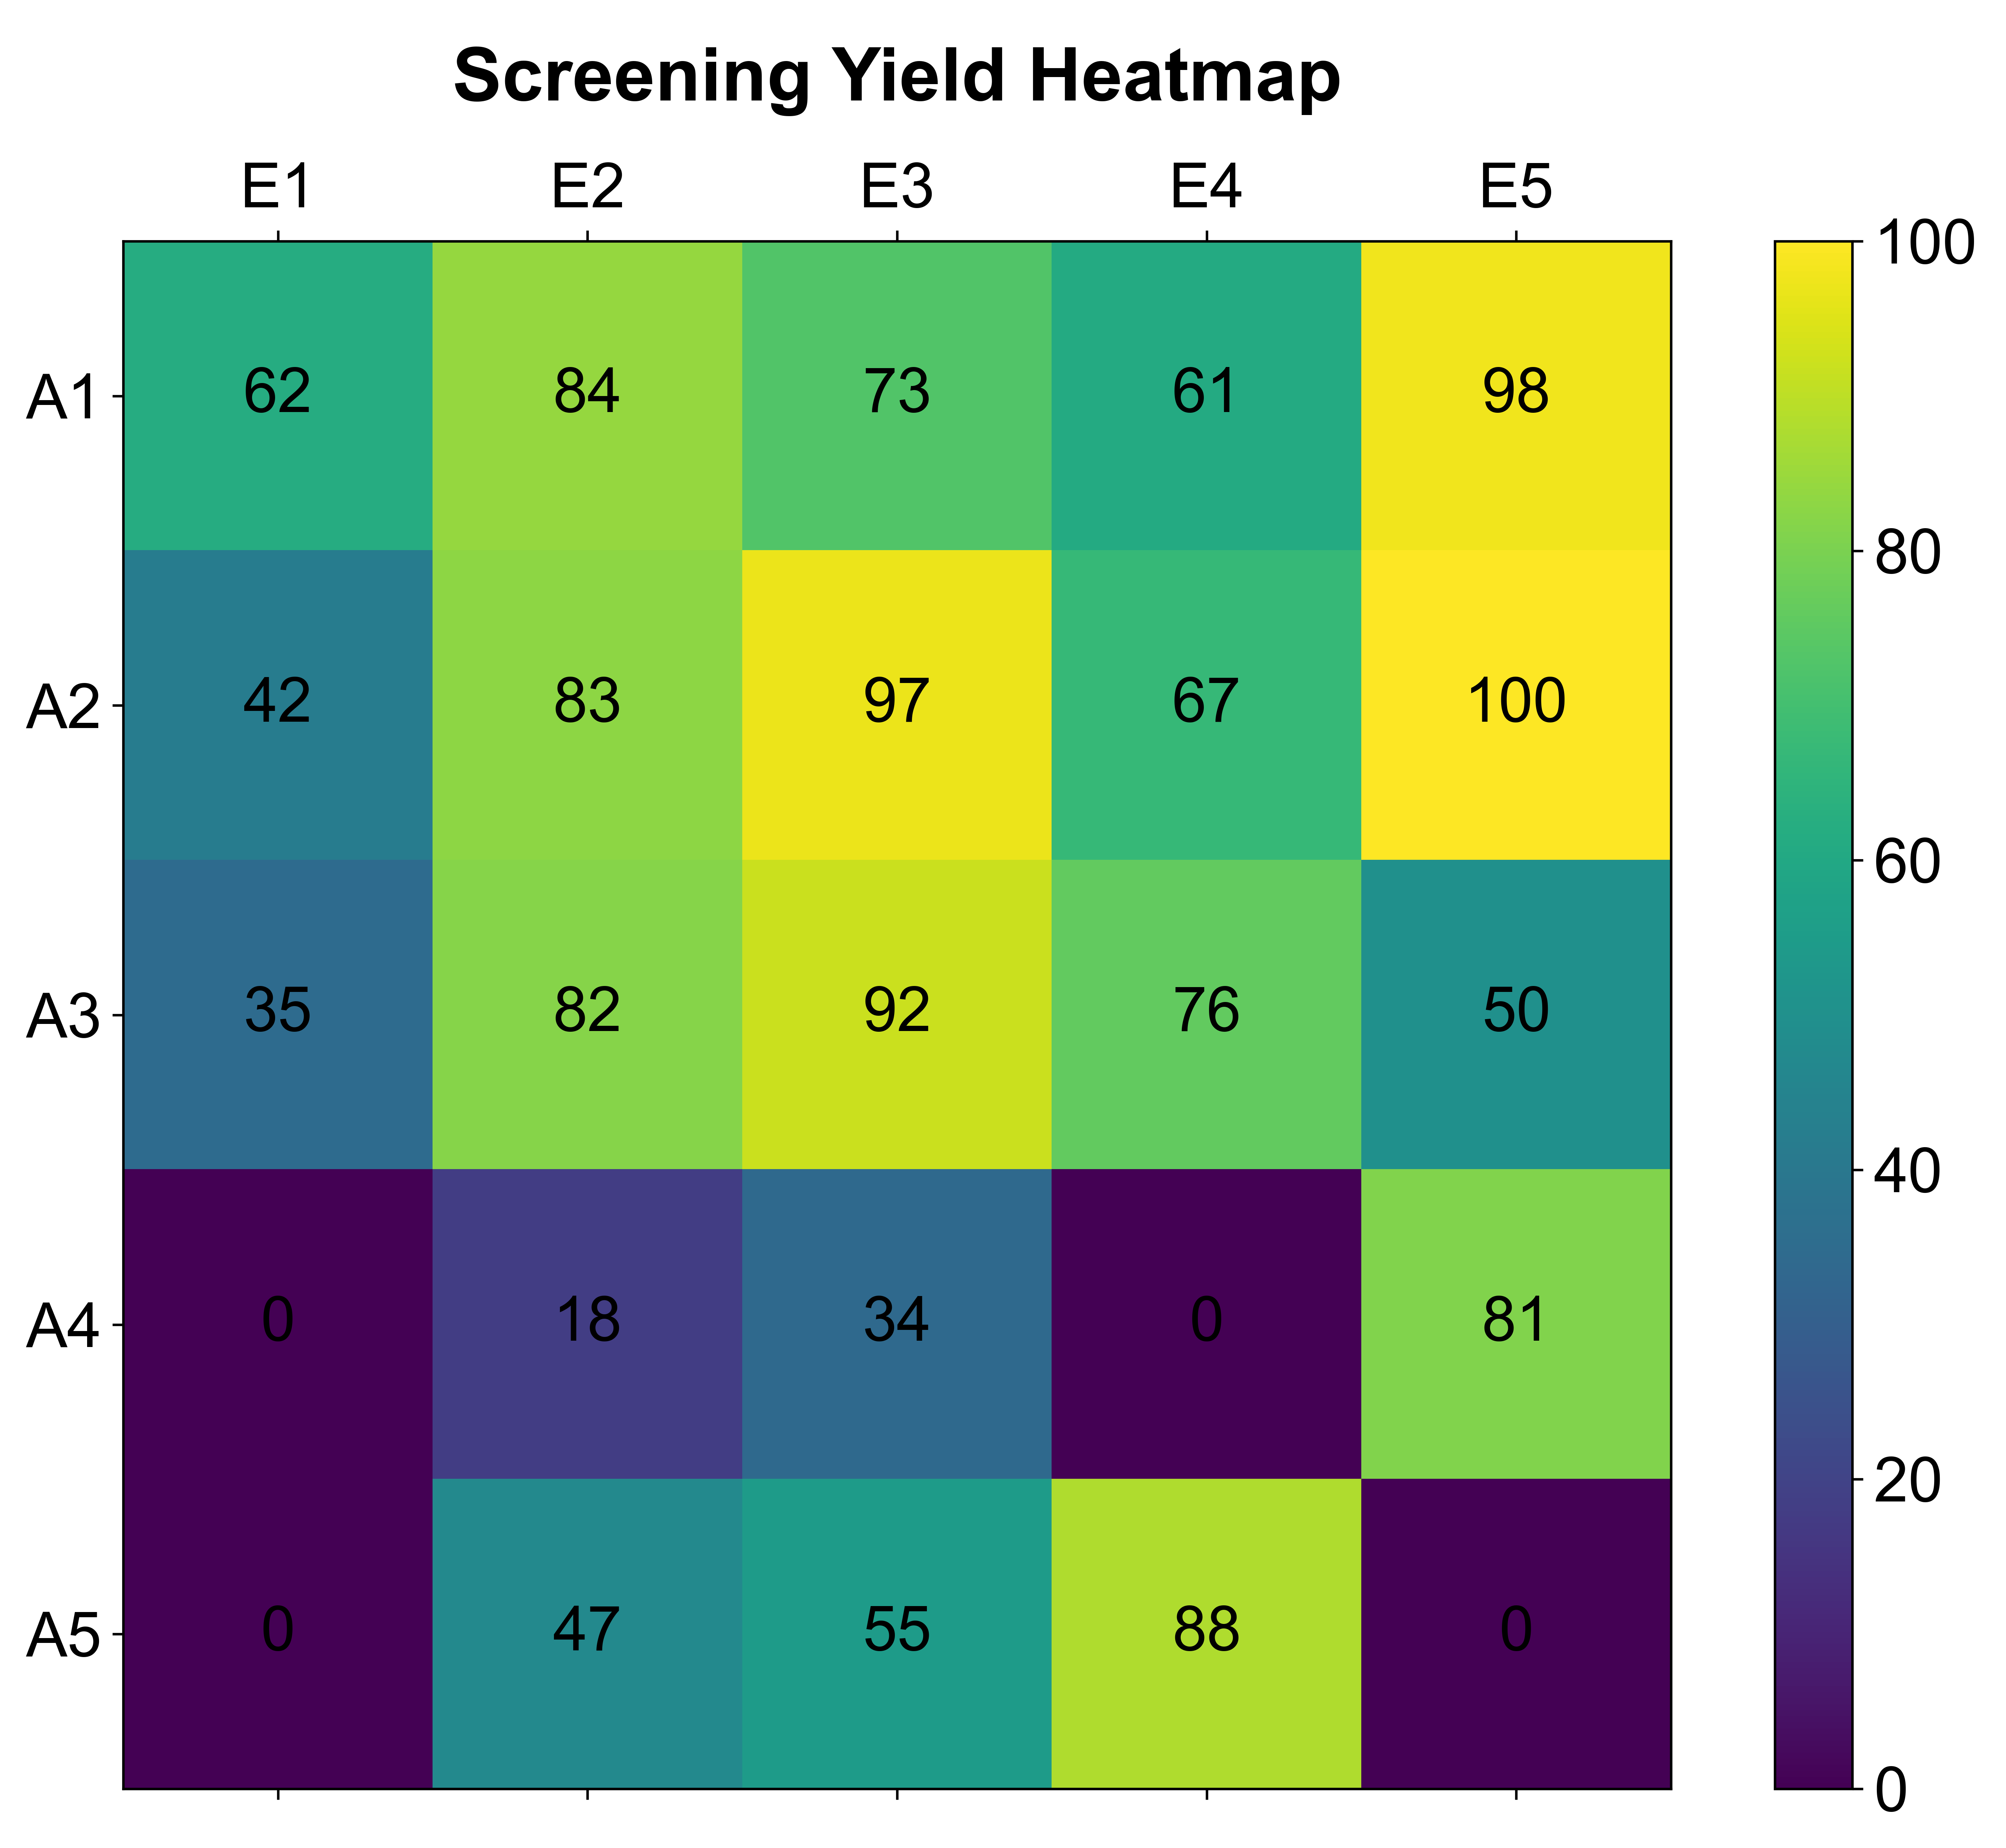

Screening of a Ni-Catalyzed Cross-Electrophile Coupling of Aryl Halides with Alkyl Halides
Tom Tan*, Brett Akana-Schneider
Department of Chemistry, University of Wisconsin-Madison, 1101 University Ave., Madison, WI 53706-1322 USA
Introduction
This project: Assess how reaction parameters affect on yield and side reaction pathways
Mechanism & Experimental Procedure
Results: Substrate stereoelectronic effect on reactivity
Reductant is crucial for the cycle.
Selective oxidative addition of Ar-X
Hypothesis: more electron-poor & less sterically hindered substrates promote reactivity
Experimental improvement: 1.5 equivalent alkyl bromide, N₂ purged solvent, smaller vial
Methods to mitigate side reaction pathway:
1. Use excess of one partner (Wurtz reaction)
2. Oxidative addition rate differentiation
3. Steric differentiation
4. Radical-chain Process (This work)
Potential side reaction with alkyl radical
Experimental procedure: A small vial containing a Teflon-coated stir-bar was sequentially added Ni(II) salt, 2,2'-bipyridine, Mn⁰ dust, sodium iodide, and solid organohalides. The vial was sealed and purged with N₂ gas for one minute. Trifluoroacetic acid and liquid organohalides were added via a syringe. The mixture was then stirred at room temperature for 1 hour. Mesitylene was used as the internal standard. After the reaction, a small aliquot was taken and washed with water three times. The organic layer was dried and prepared for an NMR sample.
Solvent Identity & Metal Salts Solubility & Atmosphere Condition on Reactivity
No reactivity following the benchtop procedure in literature, screened for the suitable reaction conditions
Scale: 0.025 mmol
Experimental:
Varying Ni salts, DMA solvent, unpurged solvents
Experimental change:
Varying solvents with NiBr₂·dme as metal salt
Experimental change:
Varying atmosphere condition and reductant load
Substrate reactivity
Conclusion
NiBr₂·dme enable reactivity, yet the conversion was low. Screened for different solvents.
Conclusion
Use NMP as solvent, NiBr₂·dme as metal salt. Smallest vials available, purge solvent with N₂.
Conclusion
No effect on between different atmosphere and reduction, purging solvent is the key.
Conclusion: Steric hindrance of alkyl halides & electrons density of aryl halides are the major factor in affecting reactivity
Summary & Conclusions
Literature cited & Acknowledgement
This study underscores the critical role of metal solubility and solvent preparation in cross-electrophile coupling reactions between aryl halides with alkyl halides, with NMP solvent and N₂-purged conditions significantly increased yields. Less sterically hindered primary alkyl halides and electron-poor aryl halides were the more reactive. Steric hindered second and tertiary alkyl substrates also exhibited reactivity albeit with lower yield. These data can provide helpful information regarding substrate selection in future synthesis using this reaction.
Everson, D. A.; Weix, D. J. Cross-Electrophile Coupling: Principles of Reactivity and Selectivity. J. Org. Chem. 2014, 79 (11), 4793–4798.
Johnson, K. A.; Biswas, S.; Weix, D. J. Cross-Electrophile Coupling of Vinyl Halides with Alkyl Halides. Chemistry – A European Journal 2016, 22 (22), 7399–7402.
Weix, D. J. Methods and Mechanisms for Cross-Electrophile Coupling of Csp2 Halides with Alkyl Electrophiles. Acc. Chem. Res. 2015, 48 (6), 1767–1775.
Biswas, S.; Weix, D. J. Mechanism and Selectivity in Nickel-Catalyzed Cross-Electrophile Coupling of Aryl Halides with Alkyl Halides. J. Am. Chem. Soc. 2013, 135 (43), 16192–16197.
Aguirre, A. L.; Loud, N. L.; Johnson, K. A.; Weix, D. J.; Wang, Y. ChemBead Enabled High-Throughput Cross-Electrophile Coupling Reveals a New Complementary Ligand. Chemistry – A European Journal 2021, 27 (51), 12981–12986.
Everson, D. A.; Jones, B. A.; Weix, D. J. Replacing Conventional Carbon Nucleophiles with Electrophiles: Nickel-Catalyzed Reductive Alkylation of Aryl Bromides and Chlorides. J. Am. Chem. Soc. 2012, 134 (14), 6146–6159.
Truesdell, B. L.; Hamby, T. B.; Sevov, C. S. General C(Sp2)–C(Sp3) Cross-Electrophile Coupling Reactions Enabled by Overcharge Protection of Homogeneous Electrocatalysts. J. Am. Chem. Soc. 2020, 142 (12), 5884–5893.
I would like to thank Dr. Brett Akana-Schneider and members of the Weix group for their generous support of this work.
I would also like to thank Alana Meyer and Nick Hill for their helpful advice and general oversight of the work.

